Slide 1

Design Pattern (Structural, Behavioral ), SOLID Principles
Java Full Stack Program

Slide 2
Structural Patterns
Structural patterns are patterns that focus on creating complex structures by making use of relations between objects and classes. Most structural patterns are based on inheritance. In this chapter, we will focus only on the following patterns:
Adapter Pattern
Bridge Pattern
Composite Pattern
Decorator Pattern
Facade Pattern
Flyweight Pattern
Proxy Pattern

Slide 3
1. Adapter pattern
The adapter pattern provides a solution for code reusability; it adapts/wraps existing old code to new interfaces, interfaces that were unknown at the design time of the original code.
Implementation
The following UML diagram models the interaction between the new client code and the adapted one.
The adapter pattern is usually implemented in other languages by using multiple inheritance, which is partially possible starting from Java 8.
We will use another approach, which works with older Java versions too; we'll use aggregation.
It is more restrictive than inheritance since we are not going to get access to protected content, just the adapter public interface:

Slide 4
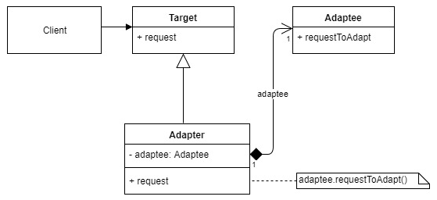
We can distinguish between the following actors from the implementation diagram:
Client : The code client
Adapter : The adapter class that forwards the calls to the adaptee
Adaptee : The old code that needs to be adapted
Target : The new interface to support

Slide 5
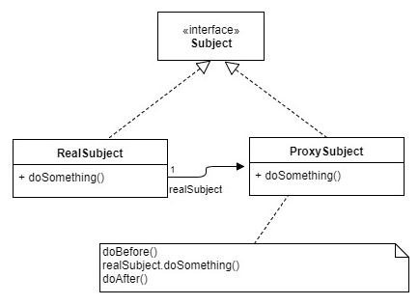
2. Proxy pattern
Implementation
The following diagram models the proxy pattern. Notice that since both the real and the proxy subjects implement the same interface, they can be interchangeable:
We can distinguish between the following actors in the implementation diagram:
Subject: The existing interface used by the client
Real Subject: The real object's class
Proxy Subject: The proxy class

Slide 6
3. Decorator pattern
Implementation
The following diagram models the decorator pattern.
It shows that the extended component and the decorated component can be replaced, one with the other.
The decorator can be applied recursively; it can be applied to an existing component implementation but also applied to another decorator, or even to itself.
The decorator interface is not fixed to the component interface; it can add extra methods, which may be used by the decorator's children, as shown in this diagram

Slide 7
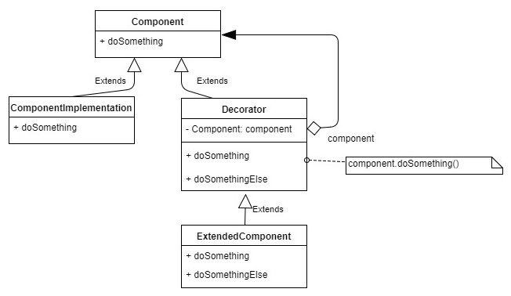
We can distinguish between the following actors in the implementation diagram:
Component: This is the abstract component (it can be an interface)
Component Implementation: This is one of the components we would like to decorate
Decorator: This is an abstract component decorator
Extended Component: This is the component decorator that adds the extra functionality

Slide 8
4. Bridge pattern
Implementation
The following diagram shows a possible bridge implementation.
Notice that both the abstraction and the implementation can change, not only the interface but also the implementation code.
For example, the refined abstraction could make use of the doImplementation3() that only the Specific Implementation offers:

Slide 9
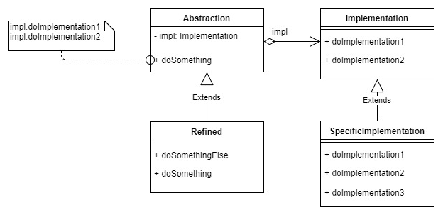
We can distinguish between the following actors in the implementation diagram:
Abstraction: This is the abstract component
Implementation: This is the abstract implementation
Refined: This is the refined component
Specific Implementation: This is the concrete implementation

Slide 10
5. Composite pattern
Implementation
The following diagram shows that the client uses the component interface do Something() method.
That method is implemented differently in root and leaf nodes.
A root node can have 1 to n children; the leaf node has none.
When the number of children is 2 and there are no cycles, then we have the case of a binary tree:

Slide 11
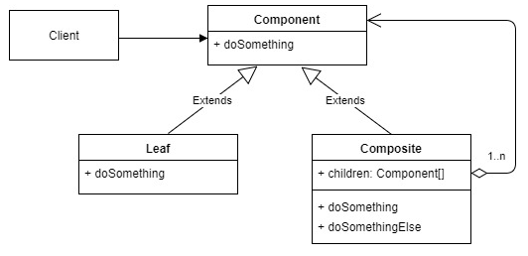
We can distinguish between the following actors in the implementation diagram:
Client: The client code
Component: The abstract node
Leaf: The leaf node
Composite: The composite node that has children that can be composite or leaf nodes

Slide 12
6.Facade Pattern
Implementation
The following diagram shows how a subsystem's usage can be simplified and decoupled from the client code.
The façade is the entry point to the subsystem; therefore, the subsystem code can easily be switched to a different implementation.
The client dependencies can also be managed more easily and are more visible:

Slide 13
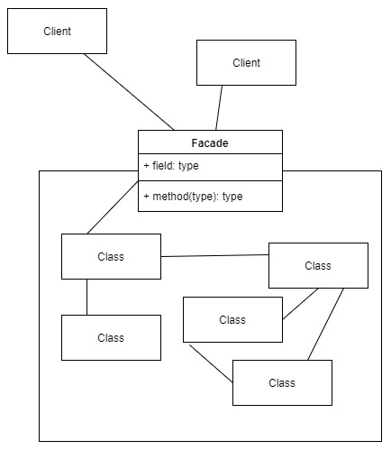
We can distinguish the following actors in the implementation diagram:
Client: The subsystem client code
Facade: The subsystem interface
Subsystem: The classes defined in the subsystem

Slide 14
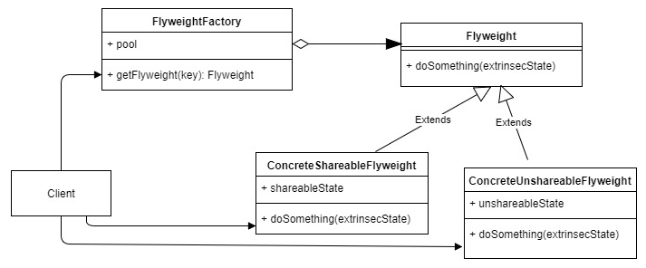
6.Flyweight Pattern
Implementation
The following diagram shows that the flyweight object is returned from the pool and, to function, it needs the external state (extrinsic) passed as an argument.
Some flyweights can share state with others, but this is not an enforced rule:

Slide 15
We can distinguish the following actors in the implementation diagram:
Client: The client code.
Flyweight Factory: This creates flyweights if they do not exist, and returns them from the pool if they exist.
Flyweight: The abstract flyweight.
Concreate Shareable Flyweight: The flyweight designed to be have a shared state with its peers.
Concreate Unshareable Flyweight: The flyweight that does not share its state. It could be composed from multiple concrete flyweights—for example, a structure made out of 3D cubes and spheres.

Slide 16
Behavioural Patterns
Behavioral design patterns are concerned with the interaction and responsibility of objects.
In these design patterns, the interaction between the objects should be in such a way that they can easily talk to each other and still should be loosely coupled.
That means the implementation and the client should be loosely coupled in order to avoid hard coding and dependencies.
There are 12 types of behavioral design patterns:
Chain of Responsibility Pattern 7. Observer Pattern
Command Pattern 8. State Pattern
Interpreter Pattern 9. Strategy Pattern
Iterator Pattern 10. Template Pattern
Mediator Pattern 11. Visitor Pattern
Memento Pattern 12. Null Object

Slide 17
1. Chain Of Responsibility Pattern
In chain of responsibility, sender sends a request to a chain of objects.
The request can be handled by any object in the chain.
A Chain of Responsibility Pattern says that just "avoid coupling the sender of a request to its receiver by giving multiple objects a chance to handle the request".
For example, an ATM uses the Chain of Responsibility design pattern in money giving process.
In other words, we can say that normally each receiver contains reference of another receiver.
If one object cannot handle the request then it passes the same to the next receiver and so on.

Slide 18
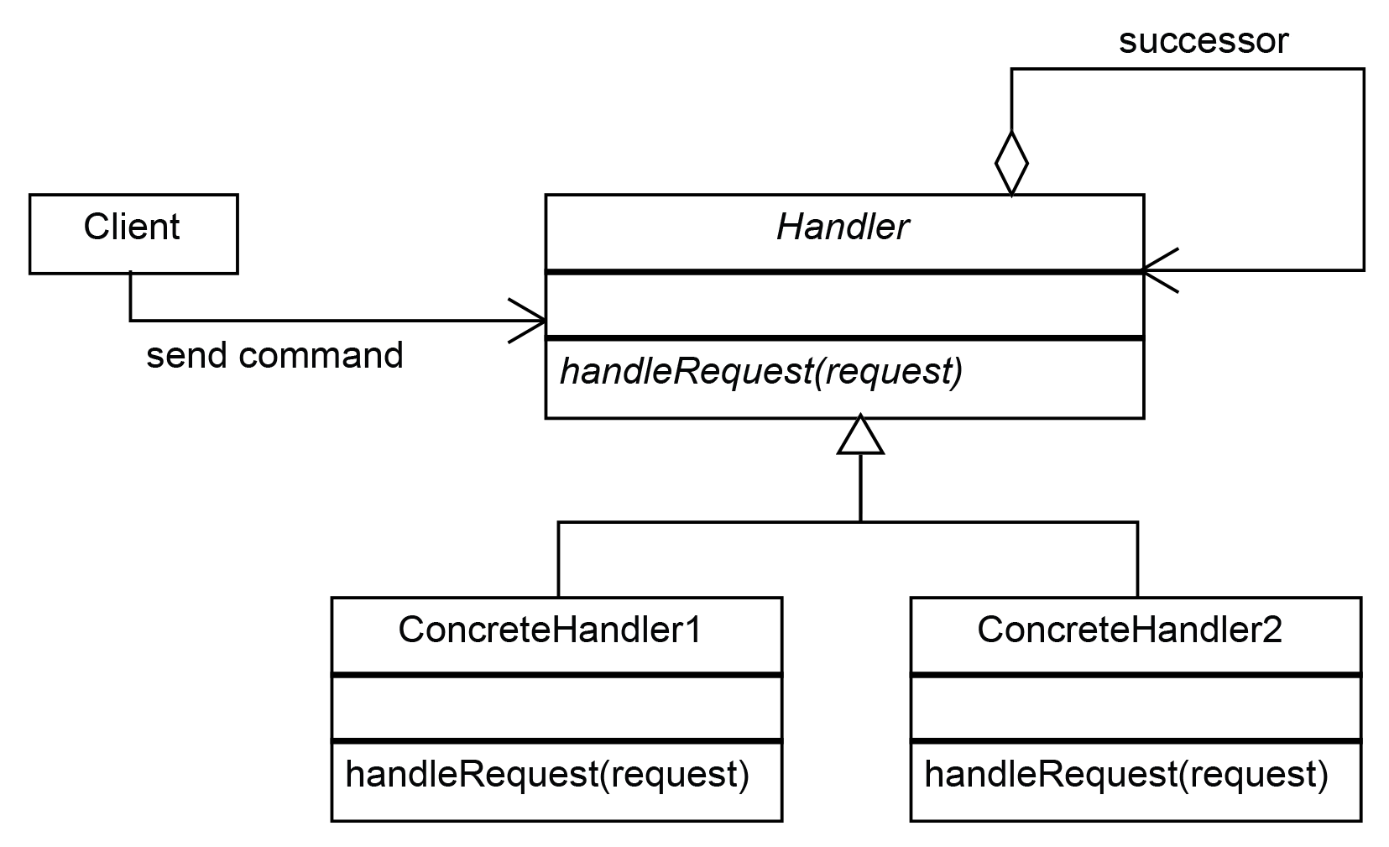
Implementation
The following class diagram describes the structure and the actors of the chain-of-responsibility pattern:
The following classes are involved in the preceding diagram:
Client: This is the main structure of the application that uses the pattern.
Handler: This is the abstract class from which all the concrete handlers have to be inherited.
Concrete Handlers: These are the concrete classes which implement a handle Request method for each case.

Slide 19
2. The command pattern
A Command Pattern says that "encapsulate a request under an object as a command and pass it to invoker object.
Invoker object looks for the appropriate object which can handle this command and pass the command to the corresponding object and that object executes the command".
It is also known as Action or Transaction.
Advantage of command pattern
It separates the object that invokes the operation from the object that actually performs the operation.
It makes easy to add new commands, because existing classes remain unchanged.

Slide 20
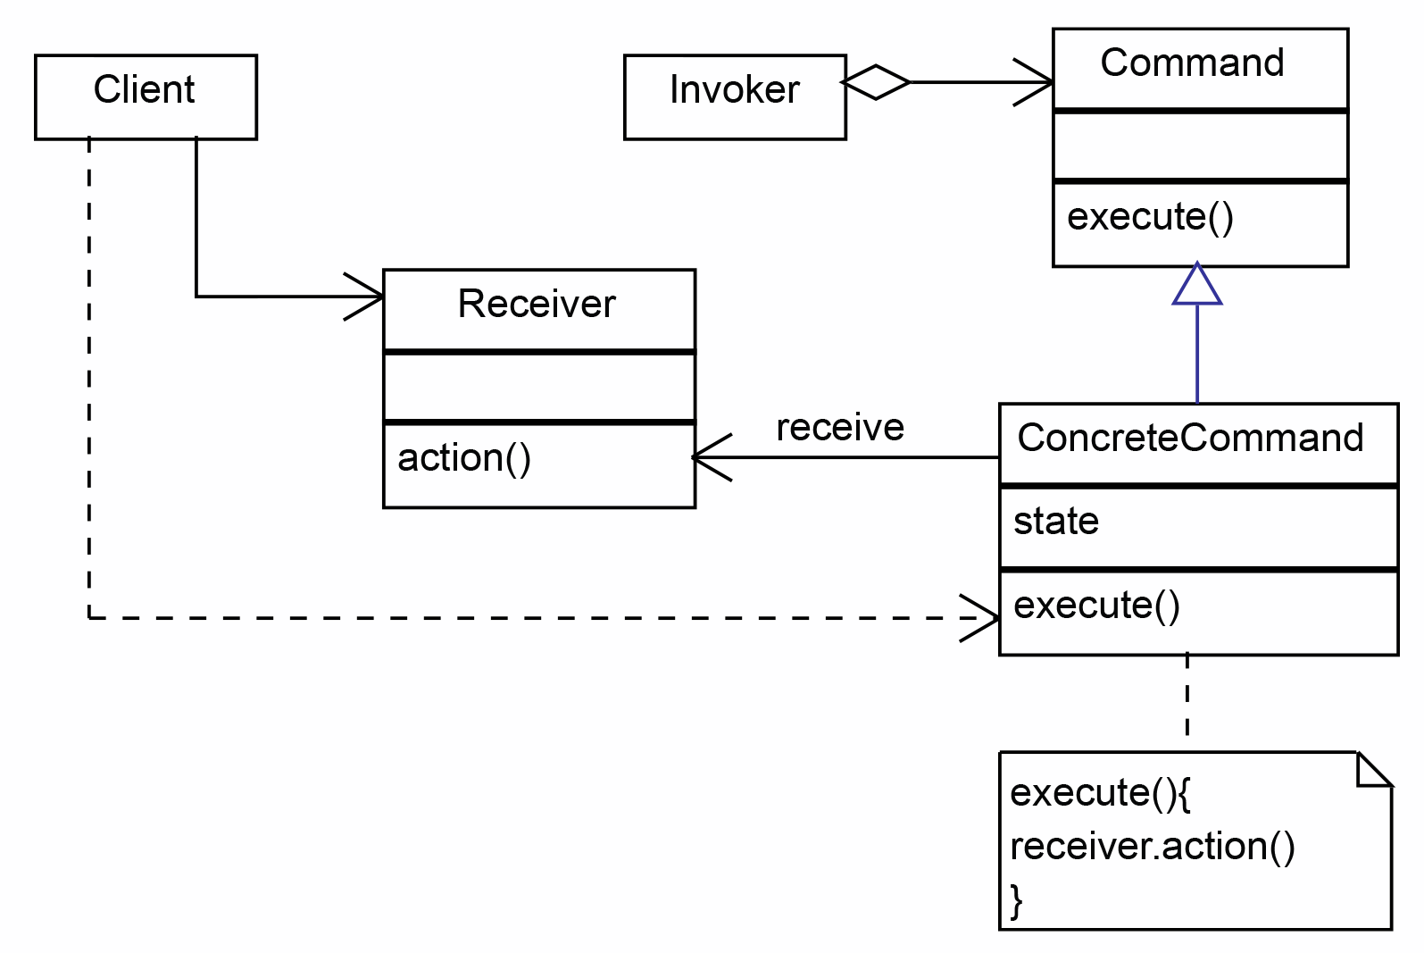
Implementation
The class diagram of the command pattern is as follows:
We can distinguish the following actors in the
preceding implementation diagram:
Command: This is the abstraction that represents
the encapsulation of a command.
Concrete Command: This is the actual implementation
of the Command
Receiver: This is the class responsible for executing the
action associated with the command.
Invoker: This is the class that triggers the command.
Client: This is the actual class that instantiates
the concrete command objects and their receivers.

Slide 21
3. Interpreter Pattern
An Interpreter Pattern says that "to define a representation of grammar of a given language, along with an interpreter that uses this representation to interpret sentences in the language".
Basically the Interpreter pattern has limited area where it can be applied.
We can discuss the Interpreter pattern only in terms of formal grammars but in this area there are better solutions that is why it is not frequently used.
This pattern can applied for parsing the expressions defined in simple grammars and sometimes in simple rule engines.
Advantage of Interpreter Pattern
It is easier to change and extend the grammar.
Implementing the grammar is straightforward.

Slide 22
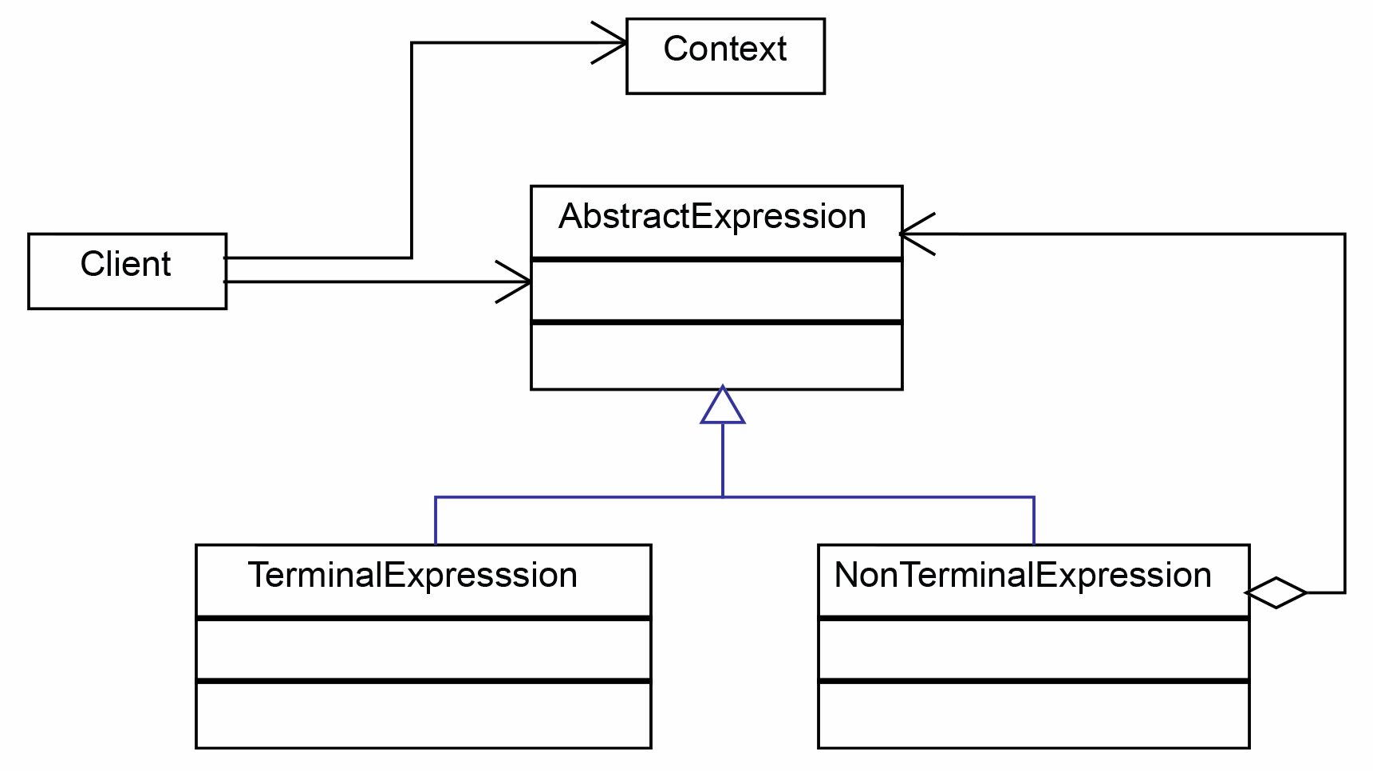
Implementation
The interpreter pattern uses the composite
pattern to define the internal representation
of the object structure.
In addition to that, it adds the implementation
to interpret an expression and to convert
it to the internal structure.
For this reason, the interpreter pattern falls
within the behavioral patterns category.
The class diagram is as follows:

Slide 23
The interpreter pattern is composed of the following classes:
Context: This is used to encapsulate the information that is global to the interpreter and needs to be accessed by all concrete interpreters.
Abstract Expression: An abstract class or interface that declares the interpret method executed, which should be implemented by all the concrete interpreters.
Terminal Expression: An interpreter class which implements the operations associated with the terminal symbols of the grammar. This class must always be implemented and instantiated, as it signals the end of the expression.
NonTerminal Expression: These are classes that implement different rules or symbols of the grammar. For each one, there should be one class created.

Slide 24
4. Iterator Pattern
According to GoF, Iterator Pattern is used "to access the elements of an aggregate object sequentially without exposing its underlying implementation".
The Iterator pattern is also known as Cursor.
In collection framework, we are now using Iterator that is preferred over Enumeration.
Advantage of Iterator Pattern
It supports variations in the traversal of a collection.
It simplifies the interface to the collection.
Implementation
The iterator pattern is based on two abstract classes or interfaces, which can be implemented by pairs of concrete classes. The class diagram is as follows:

Slide 25
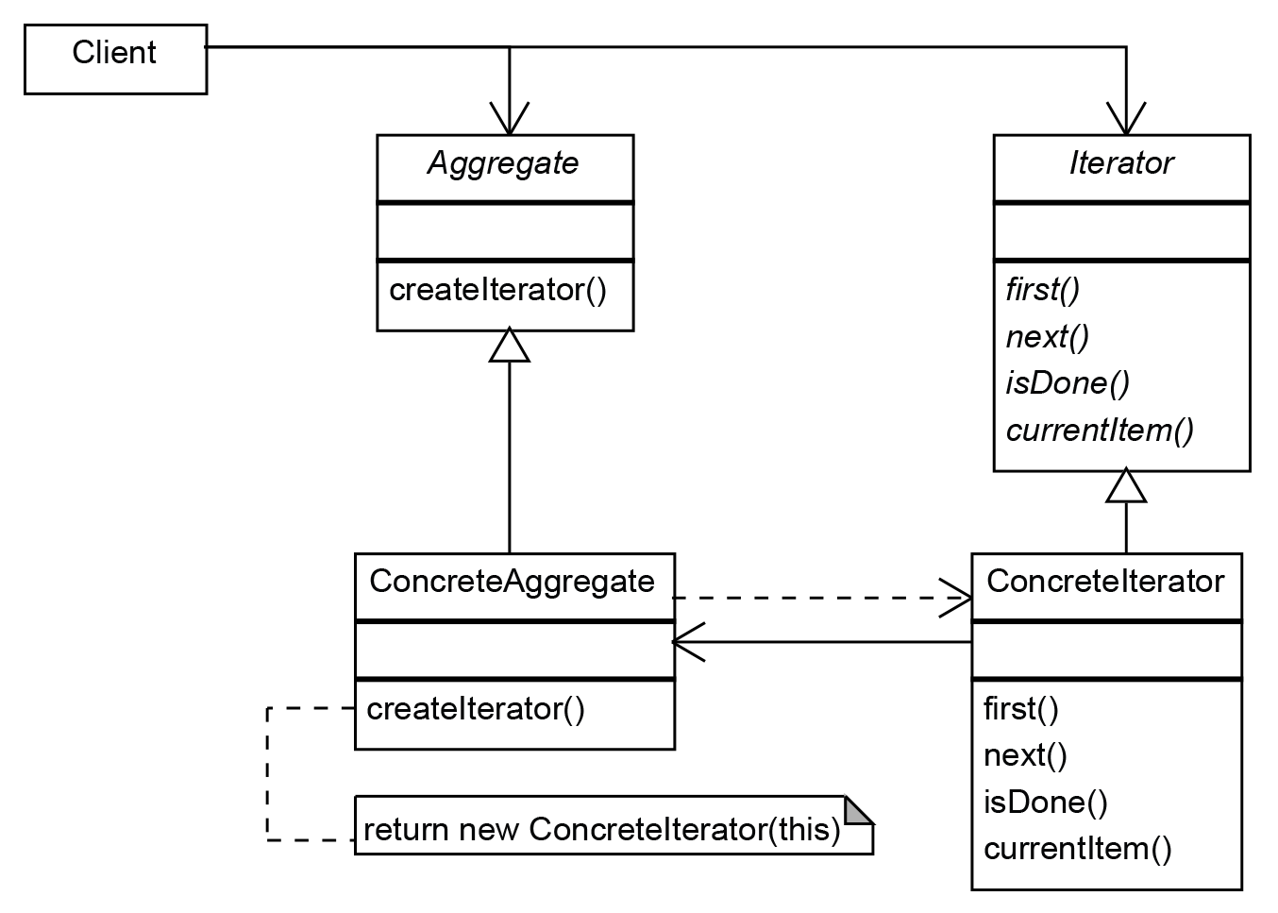
The following classes are used in the iterator pattern:
Aggregate: The abstract class that should be
implemented by all the classes and
can be traversed by an iterator.
Iterator: This is the iterator abstraction that
defines the operations to traverse the aggregate
object along with the one to return the object.
Concrete Aggregate: Concrete aggregates can
implement internally different structures, but
expose the concrete iterator, which deals with
traversing the aggregates.
Concrete Iterator: This is the concrete iterator that
deals with a specific concrete aggregate class.

Slide 26
5. Observer Pattern
An Observer Pattern says that "just define a one-to-one dependency so that when one object changes state, all its dependents are notified and updated automatically".
The observer pattern is also known as Dependents or Publish-Subscribe.
Benefits:
It describes the coupling between the objects and the observer.
It provides the support for broadcast-type communication.
Implementation
The class diagram of the observer pattern is as follows:

Slide 27
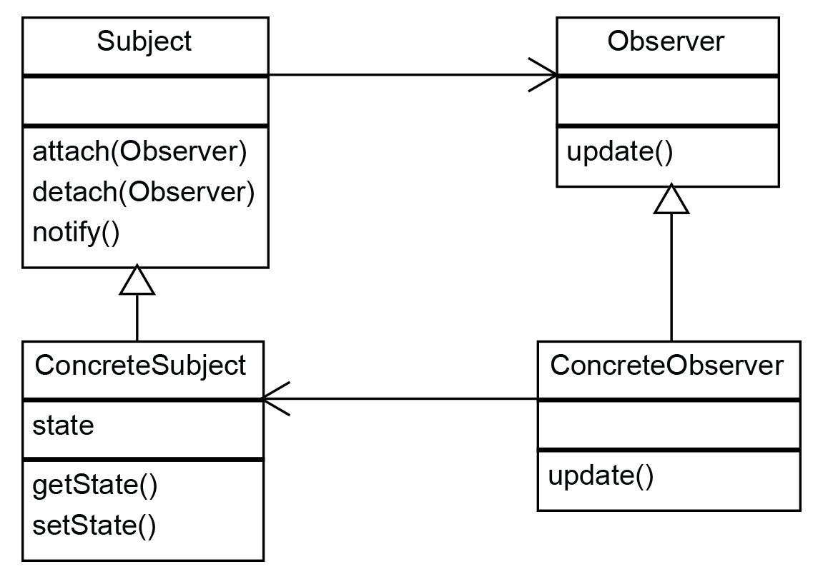
The observer pattern relies on the following classes:
Subject:
This is usually an interface that
must be implemented by the classes
and should be observable.
The observers that should be notified are
registered using the attach method.
Concrete Subject:
This is a class that implements the subject interface.
Observer:
This is an interface that is implemented by the
objects that should be updated by the changes in the subject.

Slide 28
6. Mediator Pattern
A Mediator Pattern says that "to define an object that encapsulates how a set of objects interact".
Mediator pattern is used to reduce communication complexity between multiple objects or classes.
This pattern provides a mediator class which normally handles all the communications between different classes and supports easy maintainability of the code by loose coupling.
Benefits:
It decouples the number of classes.
It simplifies object protocols.
It centralizes the control.
The individual components become simpler and much easier to deal with because they don't need to pass messages to one another.

Slide 29
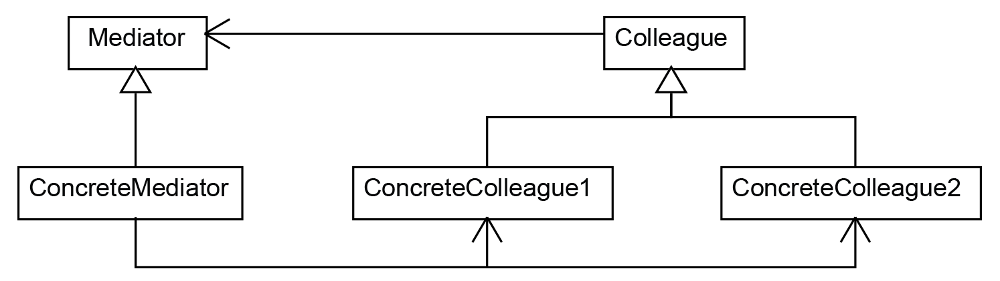
Implementation
The mediator pattern is based on two abstractions: Mediator and Colleague,
as shown in the following class diagram:
The mediator pattern relies on the following classes:
Mediator: This defines how the participants are interacting.
Concrete Mediator: This implements the operations declared by the mediator.
Colleague: This is an abstract class or interface that defines how the participants that need mediating should interact.
Concrete Colleague: These are the concrete classes implementing the Colleague interface.

Slide 30
7. Memento Pattern
A Memento Pattern says that "to restore the state of an object to its previous state".
But it must do this without violating Encapsulation.
Such case is useful in case of error or failure.
The Memento pattern is also known as Token.
Benefits:
It preserves encapsulation boundaries.
It simplifies the originator.
Implementation
The memento pattern relies on three classes: Originator, Memento, and Caretaker, as shown in the following class diagram:

Slide 31
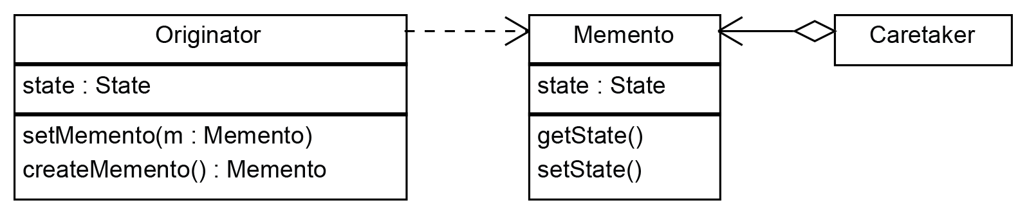
The memento pattern relies on the following classes:
Originator: The originator is the object for which we need to memorize the state in case we need to restore it at some point.
Caretaker: This is the class responsible for triggering the changes in the originator or for triggering an action through which the originator returns to a previous state.
Memento: This is the class responsible for storing the internal state of the originator. Memento provides two methods by which to set and get a state, but those methods should be hidden from the caretaker.

Slide 32
8. State Pattern
A State Pattern says that "the class behavior changes based on its state".
In State Pattern, we create objects which represent various states and a context object whose behavior varies as its state object changes.
The State Pattern is also known as Objects for States.
Benefits:
It keeps the state-specific behavior.
It makes any state transitions explicit.
Implementation
The structure of the strategy pattern is practically the same as the state pattern.
However, the implementation and the intent are totally different:

Slide 33
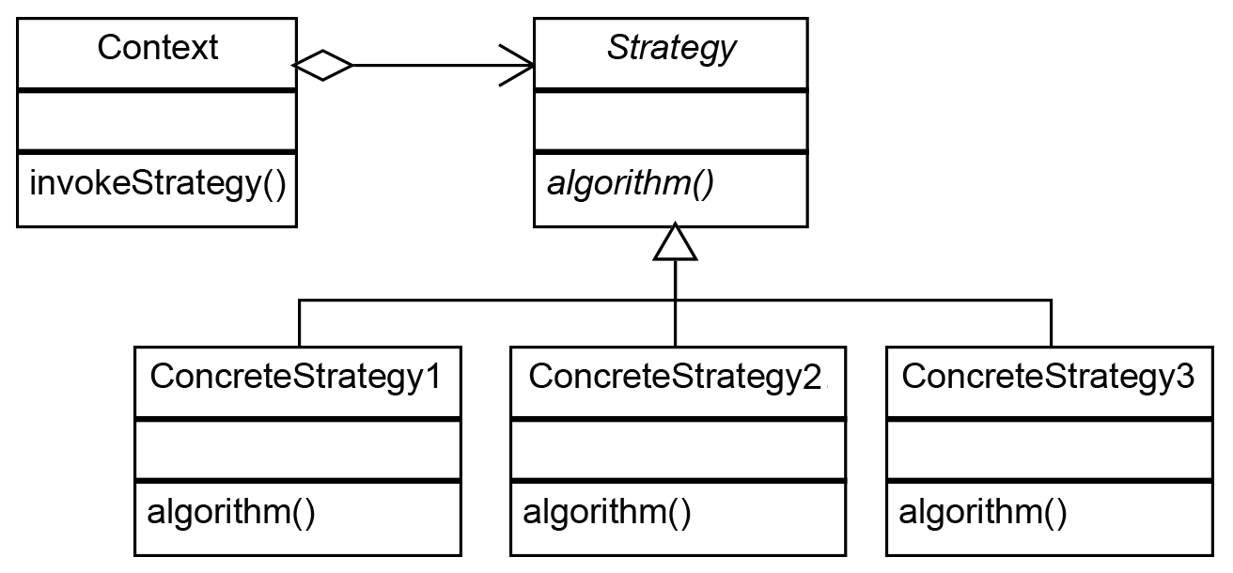
The strategy pattern is quite simple:
Strategy: The abstraction of a specific strategy
Concrete Strategy: The classes that implement the abstract strategy
Context: The class that runs a specific strategy

Slide 34
SOLID Principles
In Java, SOLID principles are an object-oriented approach that are applied to software structure design. It is conceptualized by Robert C. Martin (also known as Uncle Bob).
These five principles have changed the world of object-oriented programming, and also changed the way of writing software.
It also ensures that the software is modular, easy to understand, debug, and refactor.
In this section, we will discuss SOLID principles in Java with proper example.
The word SOLID acronym for:
1. Single Responsibility Principle (SRP) 4. Interface Segregation Principle (ISP)
2. Open-Closed Principle (OCP) 5. Dependency Inversion Principle (DIP)
3. Liskov Substitution Principle (LSP)

Slide 35
1. Single Responsibility Principle
The single responsibility principle states that every Java class must perform a single functionality.
Implementation of multiple functionalities in a single class mashup the code and if any modification is required may affect the whole class.
It precise the code and the code can be easily maintained.
2. Open-Closed Principle
The application or module entities the methods, functions, variables, etc.
The open-closed principle states that according to new requirements the module should be open for extension but closed for modification.
The extension allows us to implement new functionality to the module.
3. Interface Segregation Principle
The principle states that the larger interfaces split into smaller ones.
Because the implementation classes use only the methods that are required.

Slide 36
We should not force the client to use the methods that they
do not want to use.
The goal of the interface segregation principle is similar to the single responsibility principle.
4. Liskov Substitution Principle
The Liskov Substitution Principle (LSP) was introduced by Barbara Liskov.
It applies to inheritance in such a way that the derived classes must be completely substitutable for their base classes.
In other words, if class A is a subtype of class B, then we should be able to replace B with A without interrupting the behavior of the program.
It extends the open-close principle and also focuses on the behavior of a superclass and its subtypes.
We should design the classes to preserve the property unless we have a strong reason to do otherwise.

Slide 37
5. Dependency Inversion Principle
The principle states that we must use abstraction (abstract classes and interfaces) instead of concrete implementations.
High-level modules should not depend on the low-level module but both should depend on the abstraction.
Because the abstraction does not depend on detail but the detail depends on abstraction.
Why should we use SOLID principles?
It reduces the dependencies so that a block of code can be changed without affecting the other code blocks.
The principles intended to make design easier, understandable.
By using the principles, the system is maintainable, testable, scalable, and reusable.
It avoids the bad design of the software.

Slide 38
THANK YOU

